Slide 1
Marble Falls High School Four Year Plans
High School Registration for the Class of 2028!

Slide 2
Topics
Graduation Requirements
Honors/AP Courses
Dual Credit Courses and UT On-Ramps
Endorsements & Programs of Study
Registration!

Slide 3
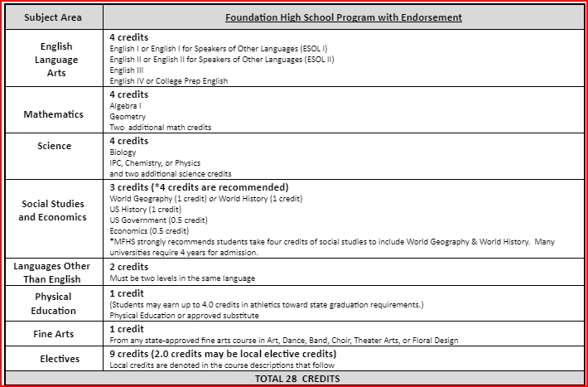
Graduation Requirements:
Red (recommended) - Colleges may require these courses
Algebra 2
Recommend including Chem., Physics and 4th science
Recommend World Geography AND World History (all 4 credits of Social Studies)
Some colleges view 3 years of a Foreign language as a plus!

Slide 4
GRADUATION PLANS
Distinguished Level of Achievement
Foundation w/ Endorsement

Slide 5
Distinguished Level of Achievement
Complete the Foundation Requirements
Complete Algebra 2
Earn an endorsement

Slide 6
Top 10% Automatic Admissions
Only students completing the Distinguished level are eligible for college admission under the Top 10% automatic admissions provision.
Texas public colleges - Top 10% ranked automatically admitted, except UT is top 6% (for this year’s Seniors)

Slide 7
Dual Credit – may have a cost to enroll.
Dual Credit is a college course that is taught on our campus.
The college credit will count at TEXAS PUBLIC UNIVERSITIES.
You will begin building your college transcript so it is extremely important that you PASS. Failing courses may affect future college financial aid.
There are strict dates for dropping or withdrawing from the course in order to avoid GPA or financial aid issues.
Two points are added to your GPA for passing grades in Dual Credit, if available to all students.
Dual Credit and UT OnRamps courses are free for ECHS students.

Slide 8
Dual Credit
You must pass the appropriate TSI or equivalent test to be considered college ready. TSI will be given to students interested in Early College High School.
To take dual credit courses, you must apply online to the appropriate college and complete all registration forms for that college. Signing up in School Links does NOT sign you up for dual credit courses.
Register online for Early College High School, forms are due February 16. See website for more information!

Slide 9
Advanced Courses Comparison: All advanced course may have a cost to enroll or test.
AP Courses
OnRamps – through UT
High school credit
Public universities award credit for exam score of 3 or higher in Texas schools
College Board curriculum
2 points added to passing grades for GPA
Can be dropped at 4 weeks and semester only
High school AND college credit with option to decline college grade
Will receive a grade for HS AND separate college grade
UT curriculum
2 points added for GPA
Can be dropped at semester only

Slide 10
Dual Credit/OnRamps vs. Honors/AP Courses
Dual Credit: 2 points GPA addition for some.
UT OnRamps: 2 point GPA addition, Grade earned on college transcript
Honors: 1 point GPA addition
All of these are good for students that do well in the classroom
AP: 2 points GPA addition, accepted by more private colleges, rigorous, college level course.
Good for students that are good test takers

Slide 11
How do I make my schedule?
Review Graduation Requirements.
Review credits earned in 8th grade through Skyward or School Links. You cannot take the same class twice!
Complete choices for your 4-year plan that meet all graduation requirements (this can be adjusted each year).
Go to the MFHS Counseling website and click on Scheduling tab – Use the course catalog to ensure you complete your chosen endorsement or use the School Links Course Guide to find Programs of Study. An endorsement is required to graduate.
Enter your choices in School Links! Your 9th grade choices will complete your course requests for 9th grade. Choices 1-8 will be your requested courses. You must also choose alternates.
If you do not pick classes, including alternates, they will be selected for you and may not be able to change!

Slide 12
How to fill out your Course Requests
Stay with me and we will fill it out together.
Review credits needed to graduate and plan your course requests accordingly.
Click on “Add another Course” for (English, Math, etc.) and options will come up to pick from that content area.
You will choose courses to fill 8 academic hours and you will choose alternates.
You can use the short cuts at the top to toggle between content areas.

Slide 13
Log-in to School Links
Log-in to “Single Sign-on”.
Click on School Links. Log-in and complete the initial information.
Click on “School” link. Click on course planner.
Select your “Program of Study”.
Select the classes to complete your 4 year plan as we guide you through the process!

Slide 14
Course Sequences for English
English 1 Regular or Honors | English 2 Regular or Honors | English 3 Regular, AP, UT OnRamps *ECHS students will take UT OnRamps (ENGL 1301 & ENGL 1302) | English 4 Regular, Dual Credit, OnRamps or AP English 4 *ECHS students will take Dual Credit (ENGL 2322 & ENGL 2323)
*Students interested in dual credit courses must fill out the required paperwork, pass the TSI and register for those classes through the college. See Mr. Teets or your counselor for more information.

Slide 15
Pick your English!
Pick your English course for all grade levels.
Be sure you check to see if you are selecting an advanced English or an on-level English.
If you fail an English course, you will be required to make that course up to graduate.

Slide 16
Course Sequences for Math
9th Grade
10th Grade
11th Grade
12th Grade
Algebra 1
Geometry
Math Models
Algebra 2
Algebra 1
Geometry
Regular
Honors
Algebra 2
Regular
OnRamps
Pre-Calculus
Regular or OnRamps
or
Another 4th math
Geometry Honors
Algebra 2
OnRamps
Pre-Cal.
OnRamps
AP Statistics,
AP Calculus

Slide 17
Course Sequences for Math
ECHS
9th Grade
10th Grade
11th Grade
12th Grade
Algebra 1
Geometry
Math Models
Dual Credit
Math 1314
Math 1342
Geometry Honors
Algebra 2
OnRamps
Dual Credit
Math 1414
Math 2412
AP Statistics,
AP Calculus

Slide 18
Pick your Math!
Pick your math course for all grade levels.
Be sure to understand if you are picking an advanced (weighted) math or an on-level math course.

Slide 19
Course Sequences for Science
9th Grade
10th Grade
11th Grade
12th Grade
Biology
IPC
Chemistry
Physics or 4th Science
Biology
Chemistry
3rd Science
4th Science
Biology
Chemistry
Physics
4th Science
Biology Honors
Chemistry 1 OnRamps
Physics, Physics OnRamps, or Chem 2 OnRamps
4th Science
*3rd and 4th year science course options are on the next slide, or in your course guide on the MFHS Counseling website.

Slide 20
3rd or 4th Year Science Options
If you failed Biology, IPC, Chemistry or Physics, you may be required to make that course up to graduate. See your counselor for options.
ON-LEVEL COURSES
ADVANCED (weighted) COURSES
Environmental Systems
Medical Microbiology (offered every other year - even years only)
Pathophysiology (offered every other year - odd years only)
Forensics
Anatomy and Physiology
Advanced Plant & Soil Science
Engineer. design & Prob. Solving
Sci. Research & Design
Biology AP
Physics OnRamps - 1or 2
Chemistry OnRamps - 1or 2
Environmental Science AP (every other year)
Advanced Animal Science (DC)
BIOL 1406 & BIOL 1407
4th year science, included on ECHS pathways

Slide 21
Pick your Science!
Students must pass Biology, and either IPC, Chemistry or Physics.
Students should have 4 science credits to graduate.
If you are graduating with Multidisciplinary as your endorsement, you must take Chemistry or Physics.
(IPC does not apply to Multidisciplinary.)

Slide 22
Course Sequences for Social Studies
9th Grade
10th Grade
11th Grade
12th Grade
World Geography
or
AP Human Geography
World History or
World History AP
US History,
Reg., AP or OnRamps
Government and Economics
Reg., AP, OnRamps or Dual Credit
ECHS Option
World Geography
or
AP Human Geography
World History,
World History AP, Dual Credit (GEOG 1303)
Dual Credit
HIST 1301 & HIST 1302
GOVT 2306
Dual Credit
GOVT 2305,
ECON 2302
GOVT 2306

Slide 23
Pick your Social Studies!
Pick your Social Studies course!
Requirements: World Geography OR World History, US History, Economics, and Government are required to graduate.
World Geography AND World History are required to get the Multidisciplinary endorsement. You cannot substitute another Social Studies course (ex. Psychology or Sociology).

Slide 24
Elective requirements to graduate
It is recommended that you complete the elective requirements in your first years of high school, because you will have more electives your Jr./Sr. year to choose from, but these must be completed to graduate.
You must get credits for the following courses to graduate:
2 credits of the same foreign language
1 credit of fine arts
1 credit of PE or PE Equivalent
1 Endorsement (usually 4 electives to complete)

Slide 25
Foreign Language
Students are required to have 2 years of the same foreign language to graduate.

Slide 26
Spanish Proficiency Exam
Students who plan to register for a Spanish course and already have some knowledge and skills in the language, have the opportunity to advance to the upper level Spanish courses.
Marble Falls ISD offers a proficiency and placement exam to determine knowledge and skill level required for entry into an upper Spanish course.
A student may place out of courses based on the outcome of the exam, which includes an objective exam, writing, and speaking sample. Credits for courses placed out of may be awarded through the exam.
A student may also receive credit for Levels 1 and 2 by taking AP Spanish IV and receiving a score of 3 or better on the AP Spanish Language exam.
The Proficiency Exam is offered several times a year. To register for the exam, please see your counselor.

Slide 27
Spanish Proficiency Exam
Students who earn Spanish 1 and Spanish 2 credit through their score on the proficiency exam have fulfilled their graduation requirement for foreign language credits.
Credits earned by exam are not included in a student’s GPA.
Students are encouraged to continue their Spanish courses throughout high school, even if they have fulfilled their credit requirements through the proficiency exam.
Additional Spanish courses taken in high school will count in the student’s GPA.

Slide 28
PE or PE Equivalent
1 credit required to graduate

Slide 29
Fine Arts
1 credit required to graduate

Slide 30
Programs of Study by Endorsement
Arts & Humanities
Fine Arts - Art
Fine Arts - Music
Fine Arts - Choir
Fine Arts - Theatre
Fine Arts - Dance/Drill Team
Fine Arts - LOTE
Fine Arts - Social Studies
Public Services
Teaching & Training
Diagnostic & Therapeutic Services
Multi-Disciplinary
4x4
AP/Dual Credit
College & Career
Business & Industry
Animal Science
Plant Science
Ag. Tech and Mech Systems (Welding)
Carpentry (Construction)
Digital Communications (A/V)
Graphic Design and Interactive Media
Graphic Design and Interactive Media (Yearbook)
Entrepreneurship
Travel, Tourism & Attractions
Marketing and Sales
STEM - must have Alg. 2, Chem. and Physics!
Engineering Foundations (Engineering or Robotics)
Math
Science

Slide 31
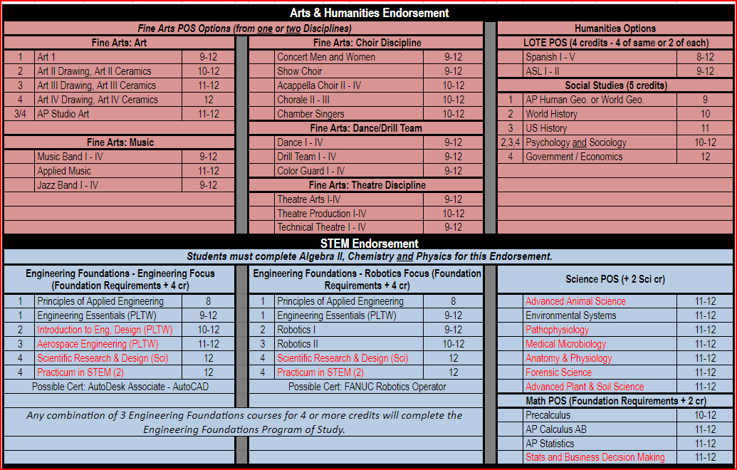
Endorsements:

Slide 32
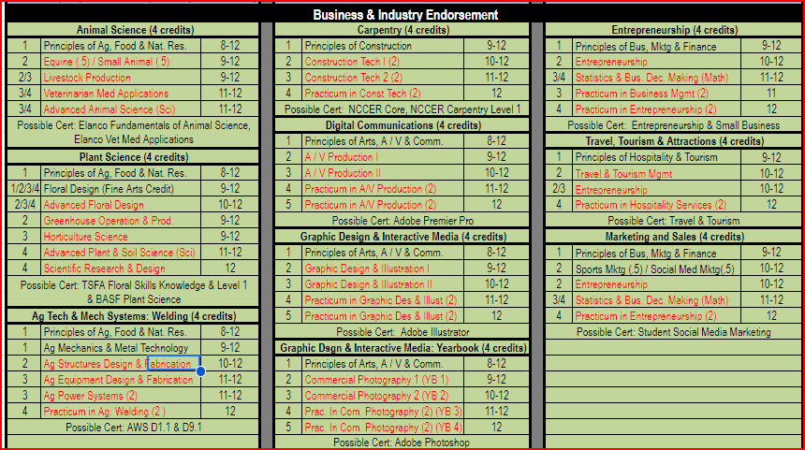
Endorsements

Slide 33
Endorsements

Slide 34
CTE and other electives Complete your endorsement!
Use your pathway to select an endorsement!

Slide 35
Next Steps:
Make sure that you have completed your 4-year plan (all classes and alternates).
Review your choices with your parents! They can make changes up until we meet with you in the hallway. After that, all changes must go through your high school counselor.
Look at the Marble Falls High School Counseling website to learn about electives and graduation requirements!
Counselors will come back to sit with each student individually to review your 4-year plan and confirm next year’s course choices.
The last deadline to make changes to your choices is May 23, 2024!

Slide 36
Contact Information
Molly Heath, Counselor (A-G)
mheath@mfisd.txed.net
Shay Bolm, Counselor (H-P)
sbolm@mfisd.txed.net
Duane Teets, Counselor (Q-Z)
dteets@mfisd.txed.net
Ashley Bernard, ECHS & CTE Coordinator
abernard@mfisd.txed.net

